Slide 1
Revision Control System

Slide 2
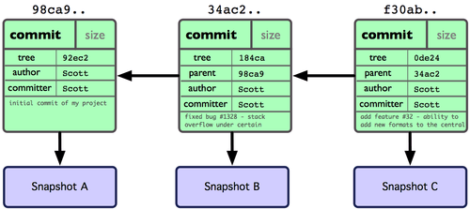
Git Branches

Slide 3
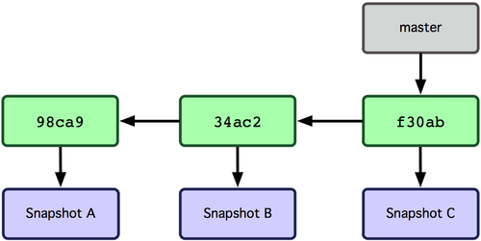
Git Branches
Branch is a movable pointer to one of the commits.
Default branch name in git is master.
master points to the last commit you made.

Slide 4
Git Branches: List branches in a project
Use command: git branch
Git puts branch information in refs/heads directory.
$ tree .git/refs/
.git/refs/
├── heads
│ └── master
└── tags
└── mytag

Slide 5
Git Branches: List branches in a project
Since master file in refs/heads directory is not compressed, you can print it using cat command. cat .git/refs/heads/master cce0cbdd3b55b8e5a3a17ce5bbd2737987892b10

Slide 6
Git Branches: List branches in a project
So, a branch is just a reference to the latest commit.
You can manage branches manually by creating or deleting files inside .git/refs/heads/
You can even rename master branch by renaming its file.

Slide 7
Git Branches: Create branch
Use command: git branch anil
See the list of branches now: git branch * master
anil

Slide 8
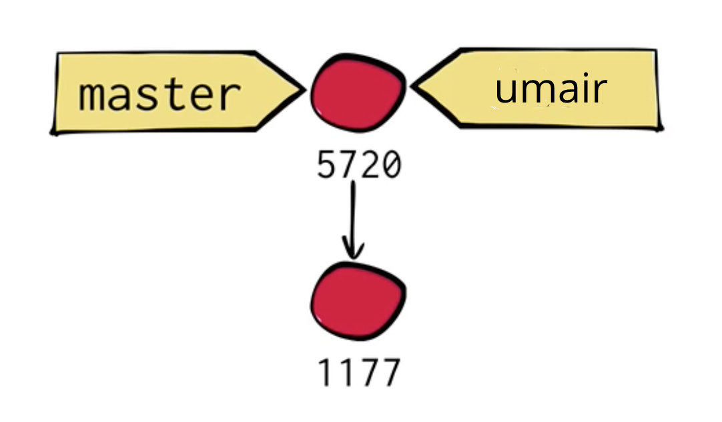
Git Branches: Create branch

Slide 9
Git Branches: Current branch
The branch that is marked with * is your current branch.
Git saves this information in a file .git/HEAD
Cat this HEAD file to see what’s inside: cat .git/HEAD ref: refs/heads/master

Slide 10

Git Branches: Current branch - HEAD

Slide 11
Git Branches
Let’s edit the apple_pie.txt file to add the ingredients and commit this file:
pastry butter flour sugar apples

Slide 12
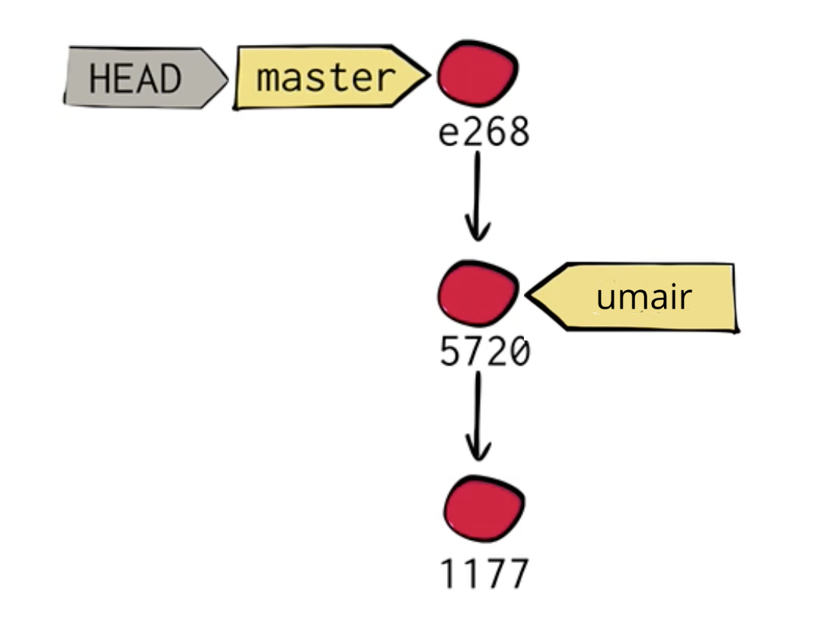
Git Branches

Slide 13
Git Branches
$ cat .git/HEAD
ref: refs/heads/master
$ cat .git/refs/heads/master
6ef3e82553f6e40edb4097c6244c70ca8fadb5b5
$ cat .git/refs/heads/anil
cce0cbdd3b55b8e5a3a17ce5bbd2737987892b10

Slide 14
Git Branches: Switch current branch
Let’s change our current branch to umair: $ git checkout anil Switched to branch 'anil'

Slide 15
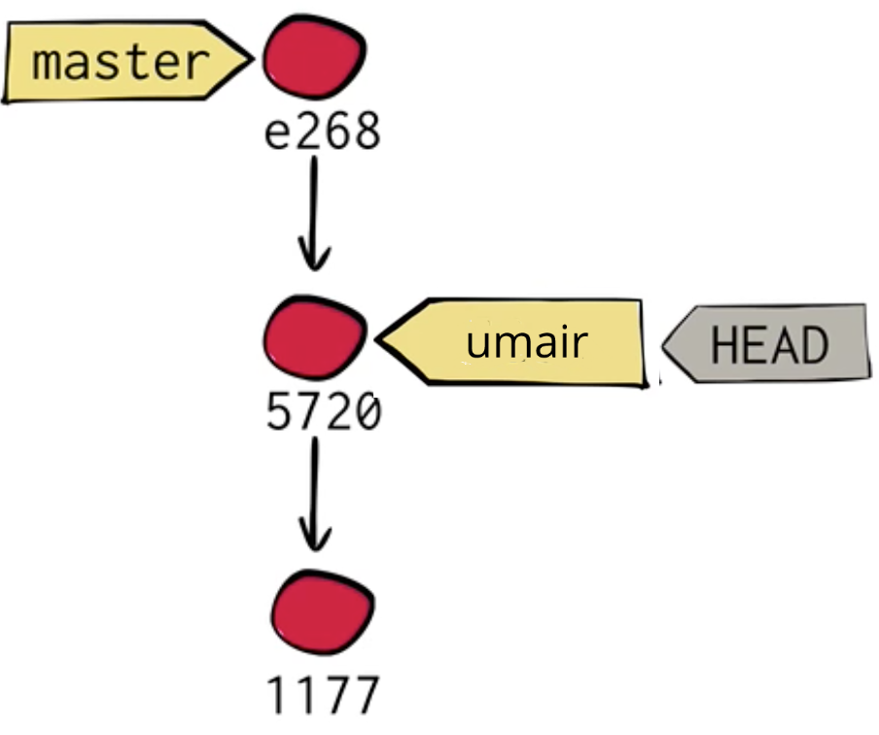
Git Branches: Switch current branch

Slide 16
Git Branches: Switch current branch
HEAD is now pointing to anil branch:
$ cat .git/HEAD
ref: refs/heads/anil
Git also replaced the files and directories in working area of the project.
$ cat recipes/apple_pie.txt
Apple Pie

Slide 17
Git Branches: Switch current branch
Let’s modify apple_pie.txt again and commit it in anil branch.
Using the same ingredients, just add cinnamon as well:
pastry
butter
flour
sugar
apples
cinnamon

Slide 18
Git Branches: Switch current branch
$ git commit -m "Add Anil’s version of the Pie"
[anil fb32e5f] Add Anil's version of the Pie
1 file changed, 6 insertions(+), 1 deletion(-)
$ git log
commit fb32e5ff9676a0b10996d0d03fbabe85530833b9
Author: Anil Pemmaraju <anil@anil.com>
Date: Sat Apr 14 11:50:24 2018 +0000
Add Anil’s version of the Pie

Slide 19
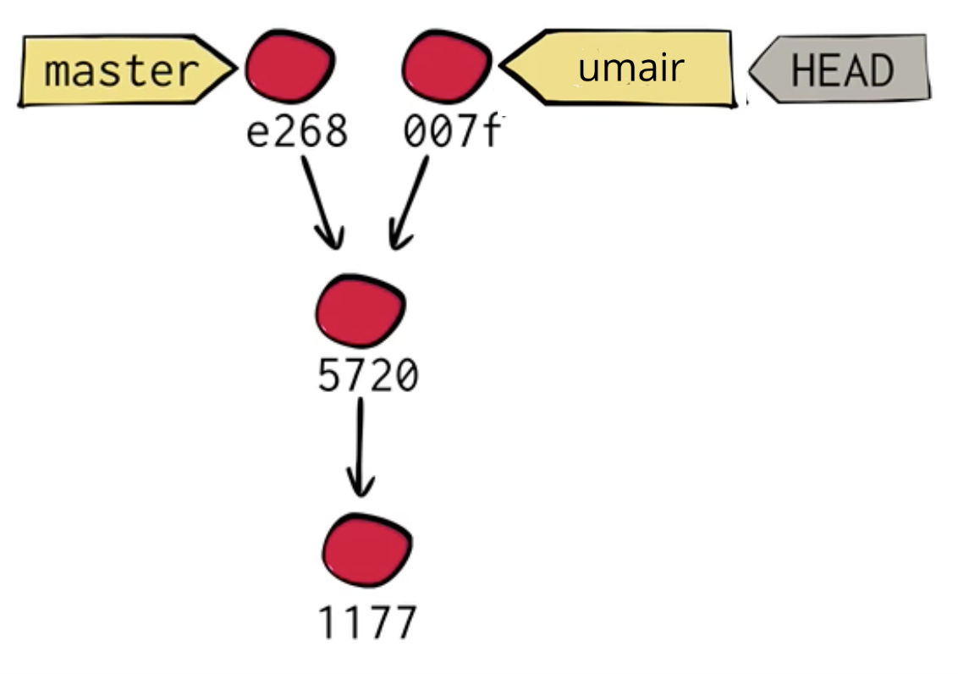
Git Branches: Switch current branch

Slide 20
Git Merge
Let’s switch back to master branch.
Now we want to merge anil’s version of the Pie recipe to master branch’s version.
$ git merge anil
Auto-merging recipes/apple_pie.txt
CONFLICT (content): Merge conflict in recipes/apple_pie.txt
Automatic merge failed; fix conflicts and then commit the result.

Slide 21
Git Merge
$ git status
# On branch master
# You have unmerged paths.
# (fix conflicts and run "git commit")
#
# Unmerged paths:
# (use "git add <file>..." to mark resolution)
#
# both modified: recipes/apple_pie.txt
#
no changes added to commit (use "git add" and/or "git commit -a")

Slide 22
Git Merge: Solve conflicts manually
To solve the conflict manually, open apple_pie.txt file using vim.
$ cat recipes/apple_pie.txt
pastry
butter
flour
sugar
apples
<<<<<<< HEAD
=======
cinnamon
>>>>>>> anil

Slide 23
Git Merge: Solve conflicts manually
Let’s use anil’s version but add quantity to cinnamon as well:
pastry
butter
flour
sugar
apples
1 tbsp cinnamon
Now add and commit this file without providing commit message.

Slide 24
Git Merge: Solve conflicts manually
Note that we don’t have to write the commit message since git knows we are in the middle of resolving merge.
Git will create a suitable message accordingly.
Git will open the text editor when you commit.
Just save the file in the editor as is.

Slide 25
Git Merge: Solve conflicts manually
Check git log -1 to see last merge commit.
git cat-file -p last commit.
$ git cat-file -p ef782046a4008b6a8ebf9ec8bf82ef63be5339f2
tree 5ffe8e49a2cc183ff3f34d8b482ae84a182a94ba
parent 6ef3e82553f6e40edb4097c6244c70ca8fadb5b5
parent fb32e5ff9676a0b10996d0d03fbabe85530833b9
author Anil Pemmaraju <anil@anil.com> 1523708122 +0000
committer Anil Pemmaraju <anil@anil.com> 1523708122 +0000
Merge branch ‘anil'
Conflicts:
recipes/apple_pie.txt

Slide 26
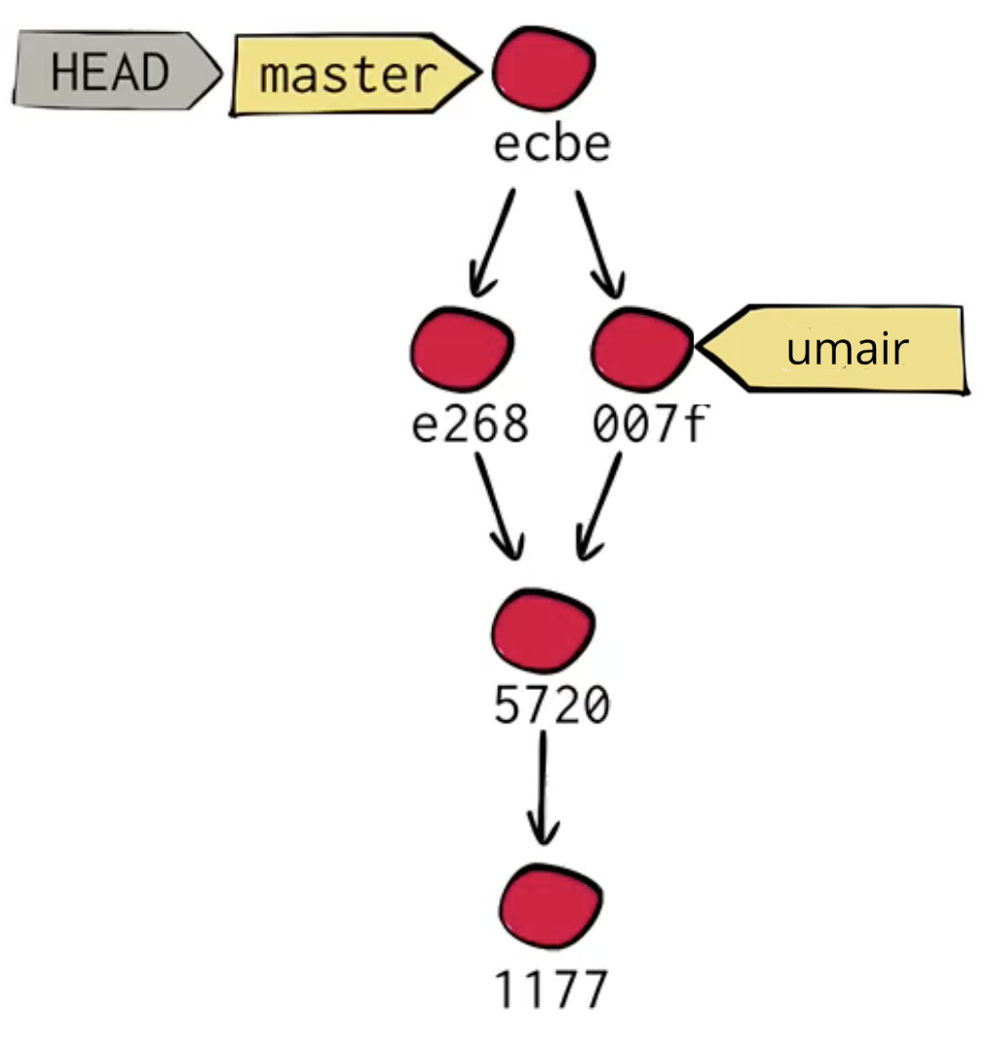
Git Merge

Slide 27
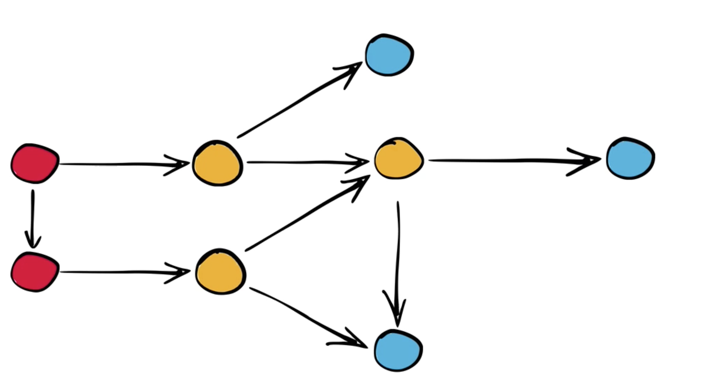
Traveling between history

Slide 28
Traveling between history
blob
commit
tree
blob
tree
commit
tree
blob

Slide 29
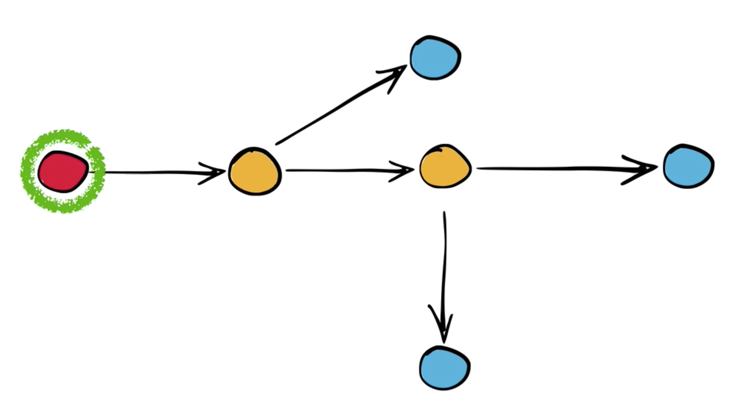
Traveling between history
blob
commit
tree
blob
tree
Entire state of the project at the time of this commit
blob

Slide 30
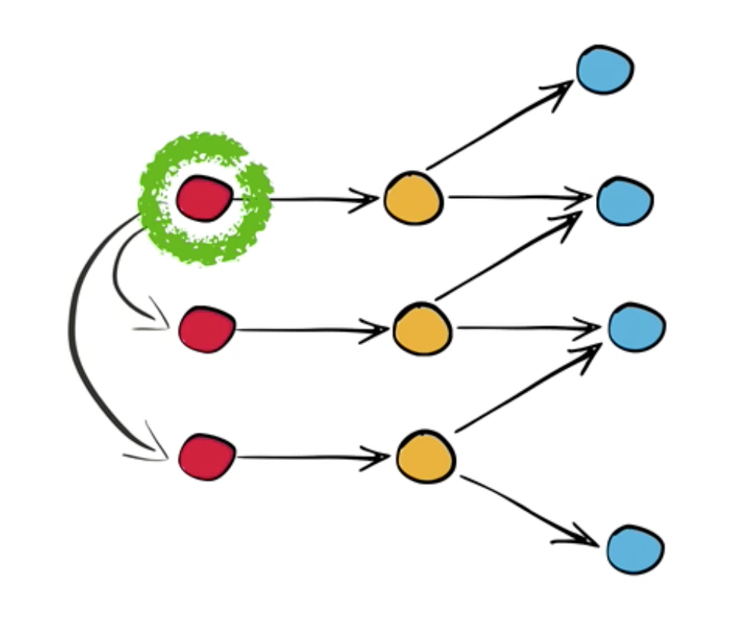
Traveling between history
Merge commits are like normal commits. The only difference is, they got two parent commits instead of one.

Slide 31
Important Points
Don’t get confused with trees and blobs
Retrieve past state in git pretty simple affair, its just a content tracker
Just focus on history how commits connects each other
Git (mostly) doesn't care about your working directory ( when you checkout git replaces the working area with the stuff from object database) . GIT cares about objects in database.

Slide 32
Merging without merging
Let’s point HEAD to ANIL branch.
Now we want to merge master into ANIL branch

Slide 33
Merging without merging

Slide 34
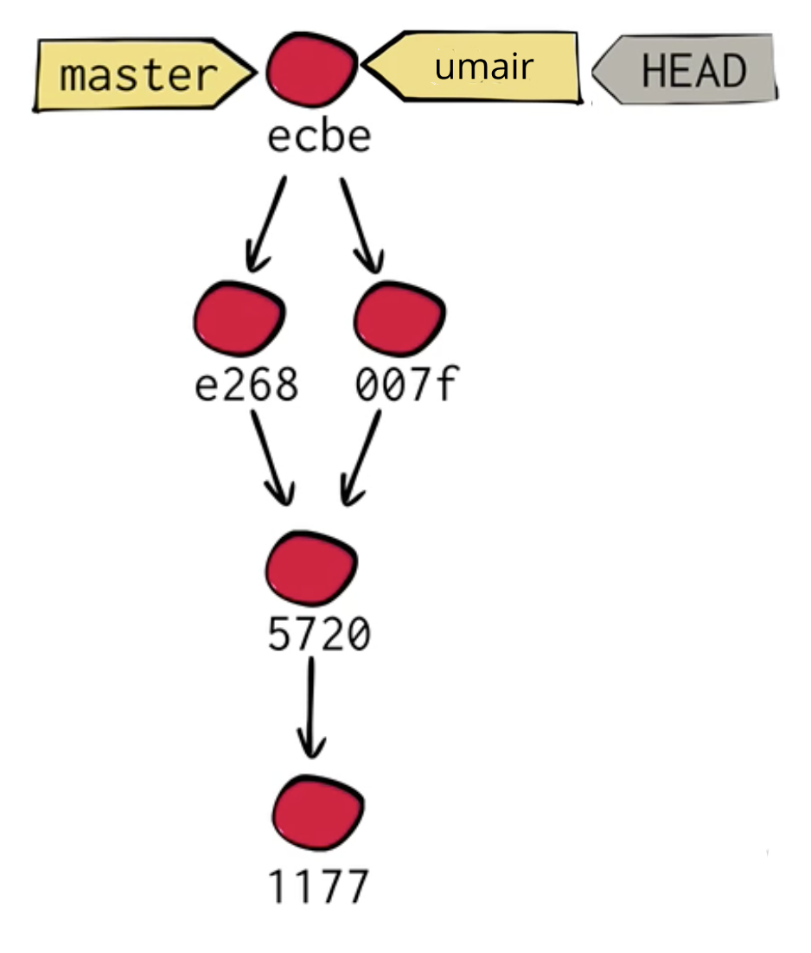
Merging without merging

Slide 35
Merging without merging
$ git merge master
Updating fb32e5f..ef78204
Fast-forward
recipes/apple_pie.txt | 2 +-
1 file changed, 1 insertion(+), 1 deletion(-)
This trick is called Fast-forward.

Slide 36

Changing HEAD
Until now, HEAD was just reference to a branch.
You can also directly checkout a commit.
This will point HEAD to a commit.

Slide 37
Changing HEAD
$ git checkout master
Switched to branch 'master'
$ git log -1
commit ef782046a4008b6a8ebf9ec8bf82ef63be5339f2
Merge: 6ef3e82 fb32e5f
$ git checkout ef782046a4008b6a8ebf9ec8bf82ef63be5339f2
Note: checking out 'ef782046a4008b6a8ebf9ec8bf82ef63be5339f2'.
You are in 'detached HEAD' state. You can look around, make experimental
changes and commit them, and you can discard any commits you make in this
state without impacting any branches by performing another checkout.
If you want to create a new branch to retain commits you create, you may
do so (now or later) by using -b with the checkout command again. Example:
git checkout -b new_branch_name
HEAD is now at ef78204... Merge branch 'anil'

Slide 38
Changing HEAD
$ git branch
* (detached from ef78204)
master
anil
Let’s change the recipe to add 20 apples to applie_pie.txt in detached head mode.
Now commit the file.

Slide 39
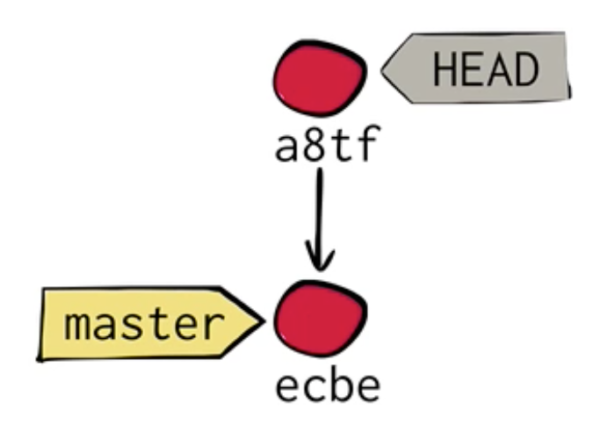
Changing HEAD
In this case, HEAD moved to the latest commit instead of branch.

Slide 40
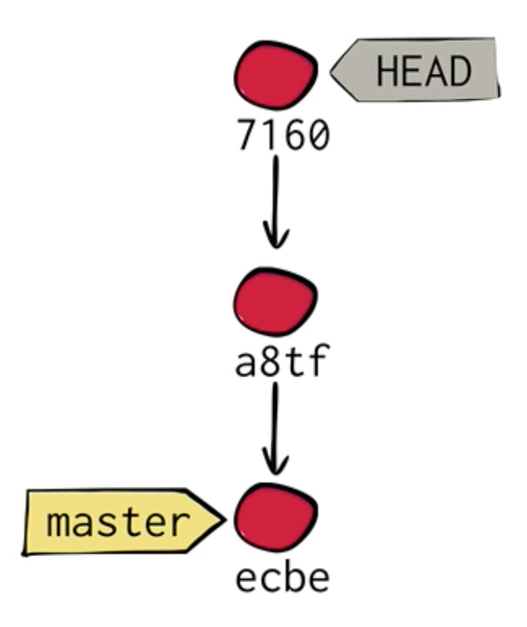
Changing HEAD
Let’s make more changes and remove sugar from the recipe.

Slide 41
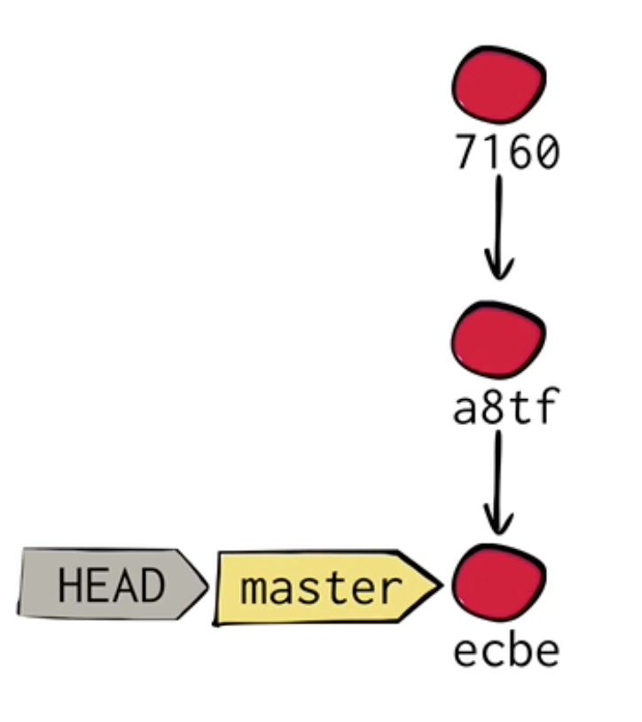
Changing HEAD
We tried making the Pie without sugar and didn’t like it.
Now we want to switch back to master branch.

Slide 42
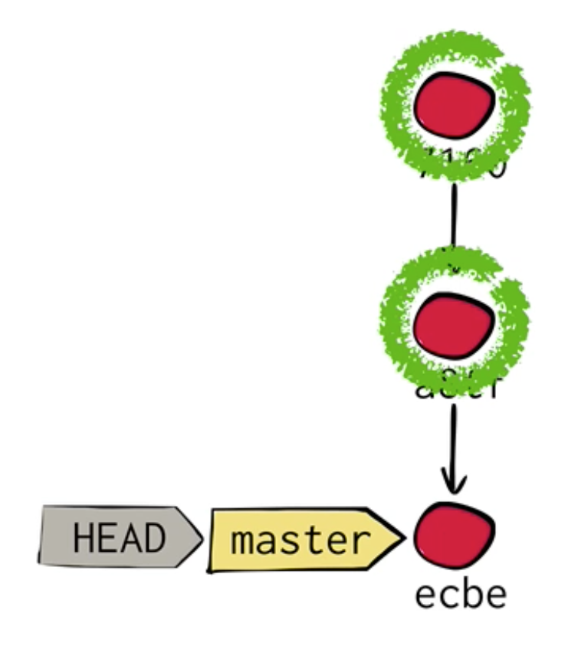
Changing HEAD
But what happened to these two commits?
Just like Object Oriented Programming languages, the objects with no reference pointing to them will be garbage collected.

Slide 43
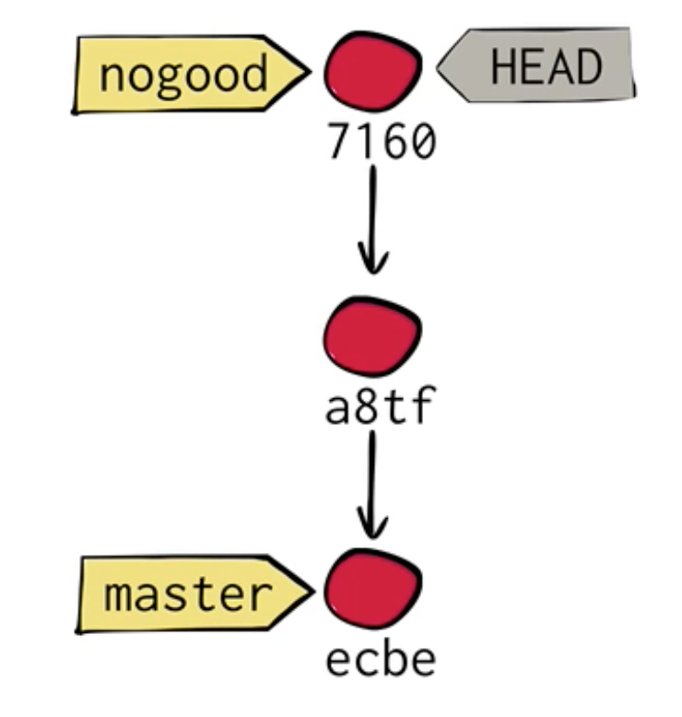
Changing HEAD
Let’s move back to the latest commit before garbage collector runs.
Then create a branch called nogood

Slide 44
Changing HEAD
You can use this trick to detach HEAD and experiment with latest code.
And commit on top of that to keep the data persistent.
Then create branch if you want to keep that data
Or checkout another branch to abandon those commits.

Slide 45
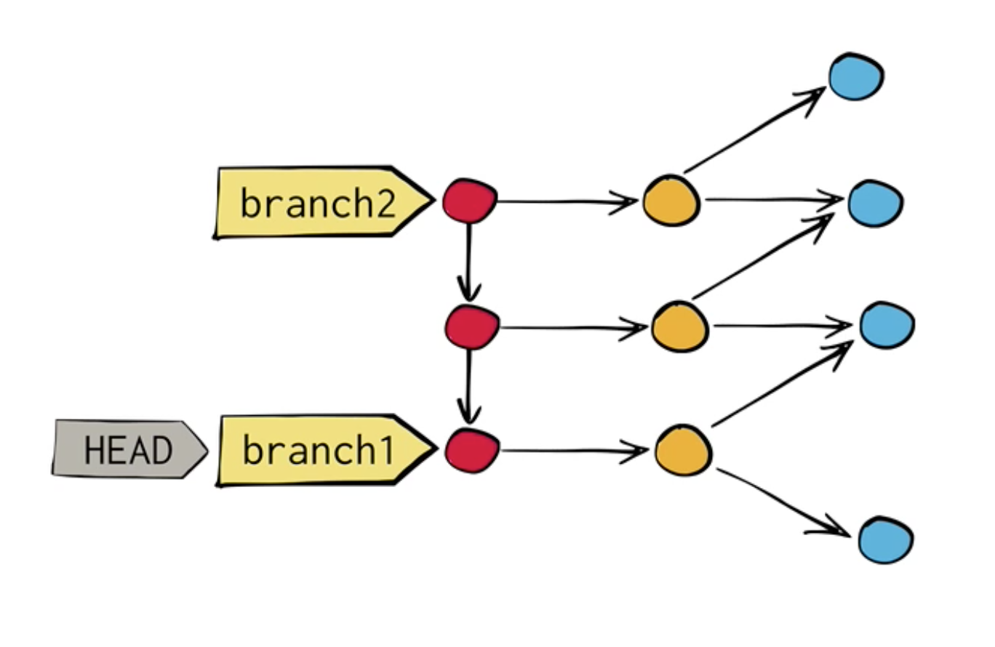
Git Object Model, Extended

Slide 46
Git Object Model, Extended: Three Rules
The current branch tracks new commits.
When you move to another commit, Git updates your working directory.
Unreachable objects are garbage collected.

